Slide 1

Introducing Hermes
By team sigma
A Progressive app for Item Sharing

Slide 2

Intro
We are Lee Jia Jie, Prannaya Gupta and Tan Kai Xun Dave, and we are Team Sigma.

Slide 3

The Problem
Currently, there is a lot of waste in this world. People throw away things which they do not need whereas others buy new versions of that very same product.
This leads to large amounts of CO2 being released into the atmosphere, through the manufacturing of the new product and the burning of the old one.

Slide 4
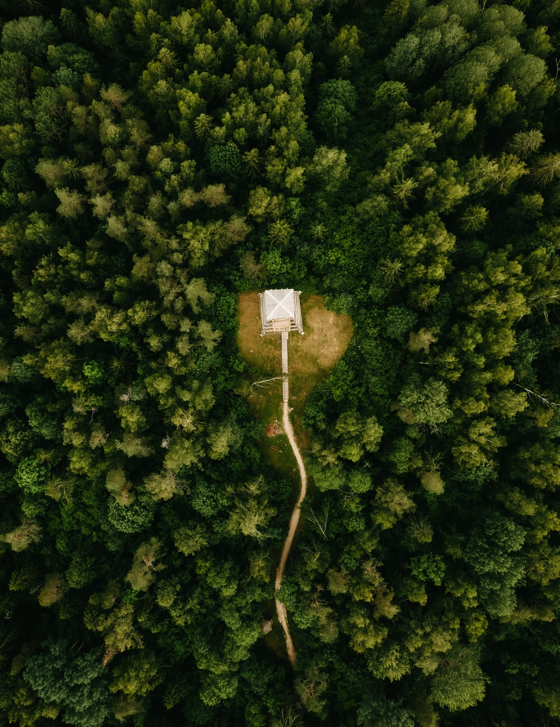
Impacts
By solving this problem, we believe that we will be able to curb the issue of climate change more directly and reduce Carbon emissions.
In addition, people may be able to get more free things that would have been otherwise thrown away, leading to better economical value.

Slide 5





Our Application
Full-Stack Deep Learning Model
MEVN Stack: Vue.js with Express/Node and MongoDB
TensorFlow Model in Python ported to JS

Slide 6
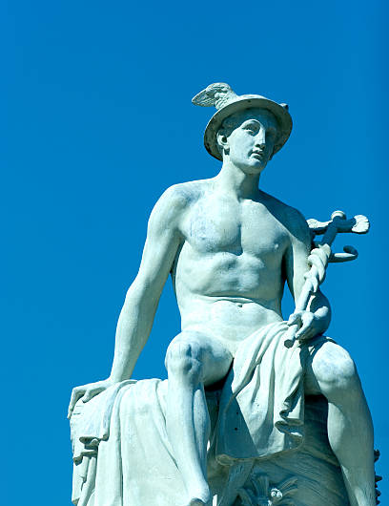
Why Hermes?
Hermes was the Greek God of Trade, Communication and Profit
Acts as a “messenger”: provides listings and facilitating in the trading of different products

Slide 7

How does it work?
Hermes is a Web Application that allows people to connect over sharing items.
Listings of multiple “wastes” – Stationery, Electronics, Food, Furniture or Tools
Contact Info given so that people can contact them regarding the items.
Users can get free stuff using the app which others would throw away anyway, hence giving a 'win-win' situation for everyone.

Slide 8

What sets this aside?
Our Application integrates Deep Learning into an otherwise Management-based system
A mixture of Software Development and AI
Convolutional Neural Network that recommends categories
Seamless use for new users

Slide 9
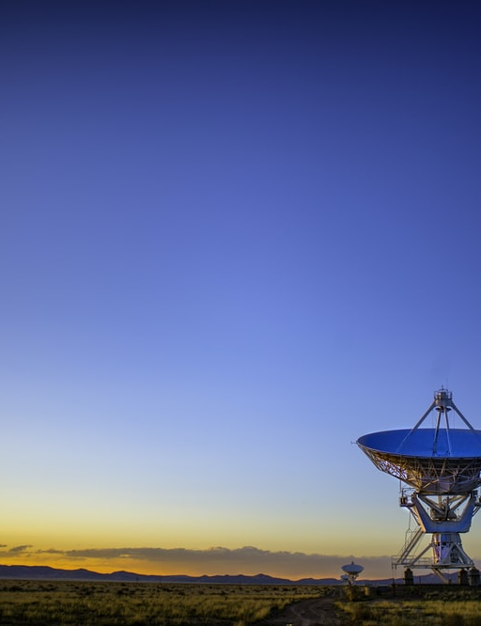
Summing Up
The problem which we identified is that people often waste or throw away products which are perfectly working which wastes a lot of carbon in both the manufacturing and destruction processes.
The solution we produced is to create a web app where people can list their unwanted items, and other people who want said items for free can come and collect it, preventing it from being wasted.

Slide 10

Thank You

